Slide 1
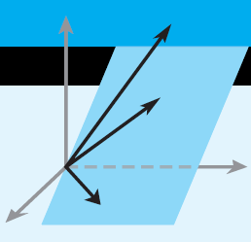
Elementary Linear Algebra
Chapter 6
Notes:
*

Slide 2
Chapter 6 Inner Product Spaces
6.1 Inner Products
6.2 Angle and Orthogonality in Inner
Product Spaces
6.4 Best Approximation; Least Squares
Notes:
*

Slide 3
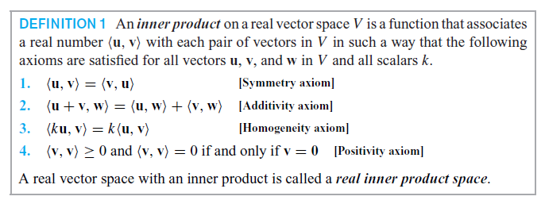

6.1 Inner Products
Notes:
*

Slide 4
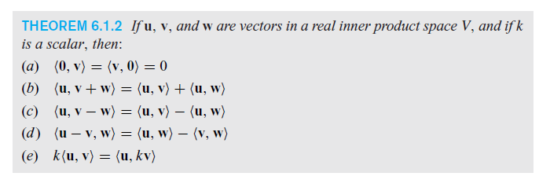
Algebraic Properties of Inner Products
Notes:
*

Slide 5
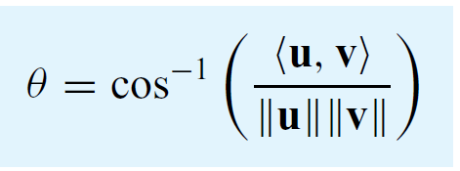
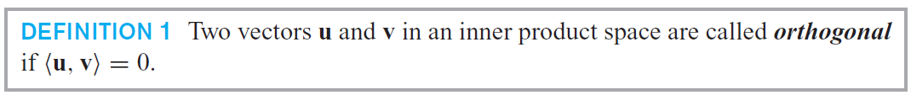
θ: the angle between u and v
Notes:
*

Slide 6
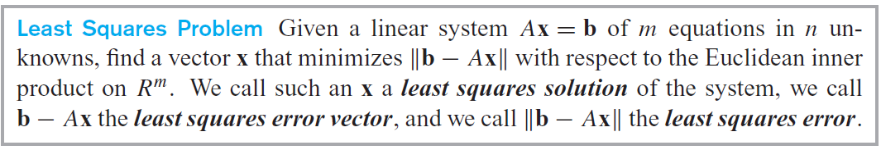
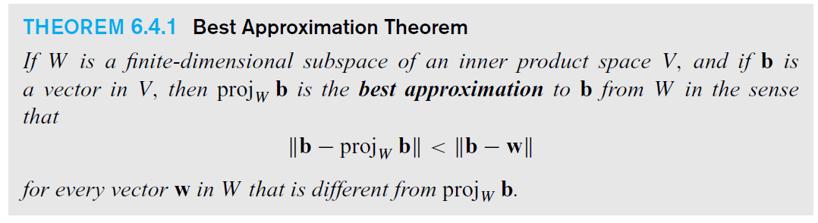
6.4 Best Approximation: Least Squares
Notes:
*

Slide 7
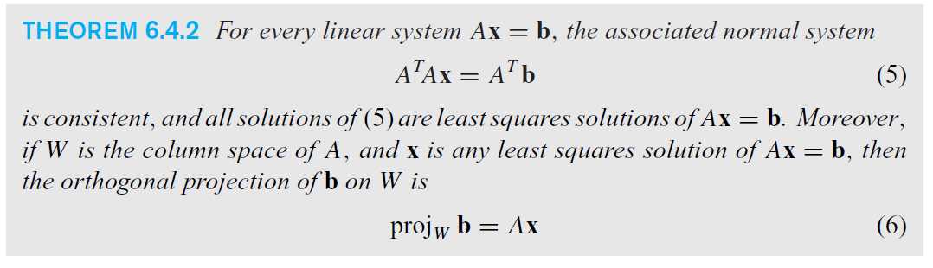
Least squares solutions to Ax = b
Notes:
*

Slide 8
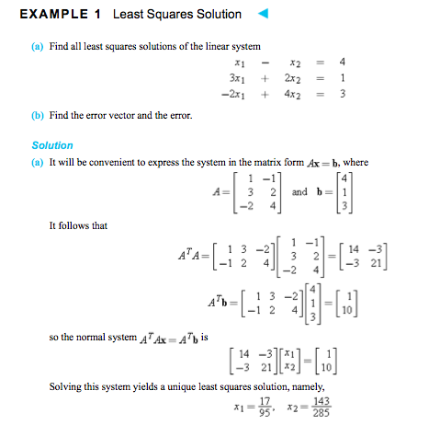

Slide 9
